Slide 1

, Presentation on Chi-square Automatic Interaction Detector(CHAID) Algorithm.
JAWAHARLAL NEHRU NATIONAL COLLEGE OF ENGINEERING Department of Information Science and Engineering
By,
Sreelakshmi Adiga P.
8th sem, ISE.
USN: 4JN16IS100

Slide 3
INTRODUCTION TO CHAID.
CHAID (Chi-square Automatic Interaction Detector) analysis is an algorithm used for discovering relationships between a categorical response variable and other categorical predictor variables.
It is useful when looking for patterns in datasets with lots of categorical variables.
It is a convenient way of summarising the data as the relationships can be easily visualized.

Slide 4
PRACTICAL USAGE OF CHAID.
CHAID is often used in direct marketing to understand how different groups of customers might respond to a campaign based on their characteristics.
For example, that we run a marketing campaign and are interested in understanding what customer characteristics (e.g., gender, socio-economic status, geographic location, etc.) are associated with the response rate achieved.
We build a CHAID “tree” showing the effects of different customer characteristics on the likelihood of response.

Slide 5
At the first level (the “trunk”) we have all customers and the overall response rate for the marketing campaign was, say, 24.3%.
As we progress down the tree to the first “branch”, we identify the factor that has the greatest impact on the likelihood of response.
Our overall population is broken down into groups (“leaves”) based upon their differing values of this characteristic – Urban/Rural
We might find that rural customers have a response rate of only 18.6%, whereas urban customers have a response rate of 28.5%.
We check to see if this difference is statistically significant and, if it is, we retain these as new leaves.

Slide 6
At the next branch, for each of the new groups (Urban/Rural), we then consider whether they can be further split into subgroups so that there is a significant difference in the dependent variable.
Urban homeowners may have a much higher response rate (36.1%) compared with urban non-homeowners (22.7%).
Rural full-time workers might have a higher response rate (24.0%) than rural part-time workers (17.8%) or the rural retired/unemployed (5.3%).
At each step every predictor variable is considered to see if splitting the sample based on this factor leads to a statistically significant relationship with the response variable.

Slide 7
If a statistically significant difference is observed then the most significant factor is used to make a split, which becomes the next branch in the tree.
The process repeats to find the predictor variable on each leaf that is most significantly related to the response, branch by branch
It is terminated only when no further factors are found to have a statistically significant effect on the response.
The results can be visualized with a tree diagram.

Slide 8
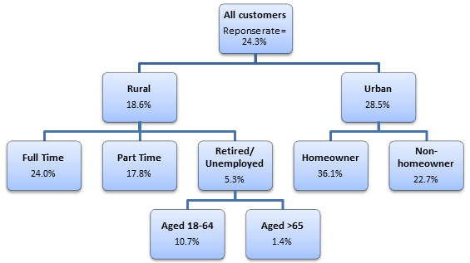
Fig.1. Tree representation of considered example after the application of CHAID algorithm.

Slide 9
In this case, we can see that urban homeowners (36.1%) have the highest response rates, followed by rural full-time workers (24.0%) and that these are therefore the best groups of customers to target.
On the other hand, the lowest response rates were observed for the rural, retired/unemployed, aged over 65 years (1.4%).

Slide 10
STATISTICAL TECHNIQUES USED.
As indicated in the name, CHAID uses Person’s Chi-square tests of independence, which test for an association between two categorical variables.
A statistically significant result indicates that the two variables are not independent.
Chi-square tests are applied at each of the stages in building the CHAID tree, as described above, to ensure that each branch is associated with a statistically significant predictor of the response variable (e.g., response rate).
Bonferroni corrections, or similar adjustments, are used to account for the multiple testing that takes place.

Slide 12
THANK YOU.

